Slide 1
Blockchain Scalability Problem
Sajan Maharjan
CSED601 Dependable Computing
20182095
28th Nov. 2018

Slide 2
Transaction Processing Speed
VISA & MasterCard Payment System – 24000 TPS
Bitcoin Blockchain – 3.3 to 7 TPS
Ethereum Blockchain – 15 to 20 TPS

Slide 3
Research Problem: The Scalability Problem?
Early design of blockchain did not consider its widespread use
Interest in blockchain technology has soared with new releases of tokens, coins and Dapps
Due to limit on transaction processing capability, increased use of blockchain applications will cause the system to crash or yield high latency
This situation can be considered as an availability (readiness for service) issue of blockchain networks. [Also concerns with security]
Notes:
Now, this may look very impressive, but here is the thing, the initial design of cryptocurrencies was not meant for widespread use and adaptation. While it was manageable when the number of transactions was less, as they have gotten more popular a host of issues have come up.

Slide 4
More on The Scalability Problem
Problem of Scalability is due to
Block Size / Transaction Limits per blocks [1MB Bitcoin Block Size/ 6.7 M Gas Limit per Ethereum Block]
Block Generation & Confirmation Time [10mins/block requires 6 confirmations & 15seconds/block requires 12 confirmations ]
“If you want to pay for a cup of coffee in Bitcoin/Ethers, are you willing to wait for an hour/few minutes just for confirmation of transactions?”
Image Courtesy: https://media.tenor.com/images/7b1db8a92b657a9484e7bbb15d1c200b/tenor.gif

Slide 5
Proposal
Research and explore on the existing proposed solutions to Scalabality
Design/model a solution to the blockchain scalability problem

Slide 6
Existing Proposed Solutions
Layer 1 solutions
Forking – change/update to the blockchain protocols or divergence from the previous version of blockchain
Eg. Block Size Increase, Change of Consensus Algorithms – PoW to DPoS, Sharding
Layer 2 solutions
Doesn’t require forking, as changes only made to the layer above base layer
Another layer that operates on top of secured base layer of blockchain
eg. Off-chain, Side-chain

Slide 7
Layer 1 Solutions - Block Size Increase
Initial block size of 1MB in Bitcoin was used to prevent spam transactions in network
Using Segregated Witness (a soft-fork for change in transaction format), more number of transactions could be added
Vertical Scaling solutions
Eg. Bitcoin Classic- block size increased to 4MB with 8000 transactions per block
More work done by each node => Favors Powerful Nodes => Centralization

Slide 8
Layer 1 Solutions - Change of Consensus Algorithm
Bitcoin & Ethereum currently employ Proof of Work consensus algorithms
In PoW, any node can participate without having anything at stake
Consensus is more difficult to achieve as the size of nodes/network increases
Can cause delay in transaction confirmation
Participation of every participating node in transaction validation makes the transaction process slower.
In PoS/DPoS, nodes stake their assets to participate in mining
Easier to reach consensus as there is a smaller no. of delegates/stakeholders
Results in faster block generation and confirmation
Semi-centralized
eg. EOS (21 block producers / 3000 TPS)

Slide 9
Layer 1 Solutions – Sharding
Shards – a piece or fragment
Using Sharding, each node will only store a part of the data on the blockchain and not the entire information
Involves splitting a blockchain into different sections called shards, each of which can independently process transactions
Requires Proof of Stake consensus algorithm
Horizontal scaling solution i.e. throughput increases as the mining network expands
Improves transaction throughput

Slide 10

Layer 1 Solutions – Sharding (contd…)
Parallel Processing of unconnected subset of transactions
Sharding can also reduce transaction fees as nodes require less processing to validate transactions
Ziliqa is a public blockchain that uses sharding mechanism to improve transaction throughput (2500 TPS)
Implementation complexity, inter shard communication complexity, security could be compromised
Image Courtesy: https://i.ebayimg.com/images/g/a2wAAOSwY6FZ3s8U/s-l300.jpg

Slide 11
Layer 2 Solutions – Off Chain
Cuts down data processing on the blockchain by running computations off-chain
Rely on the security of the base chain
Record final transaction/settlement on the main chain while small transactions details are maintained off-chain
Transfer Agreement, Escrow, Coupon based payment
Eg. Rather than maintaining daily record of grocery purchase, maintain the final cumulative transaction at the end of month
Off chain transactions are instantaneous
Eg. Bitcoin Lightning Network, Ethereum Plasma

Slide 12
Layer 2 Solutions – Sidechains
A separate blockchain attached to the main chain that facilitates trading of assets both ways
Sidechains are independent of main chain. Needs it own miners or block producers
Sidechains run in parallel with mainnet and doesn’t boggle the main net.
People can send funds and use DApps through a sidechain, which takes pressure off the main-chain and allows for it to operate with faster and cheaper transactions.
Sidechains can have problems of security since each sidechain is responsible for its own miners
Notes:
You take a snapshot of the actual state of ethereum blockchain, then you work with your assets/tokens on sidechain in order to decongest ethereum net. So, block validation is done on sidechain, not in the ethereum net. Therefore, Sidechain takes all the work and at some point in time the sidechain give its state to ethereum network so the prious state can be update with the current state.

Slide 13
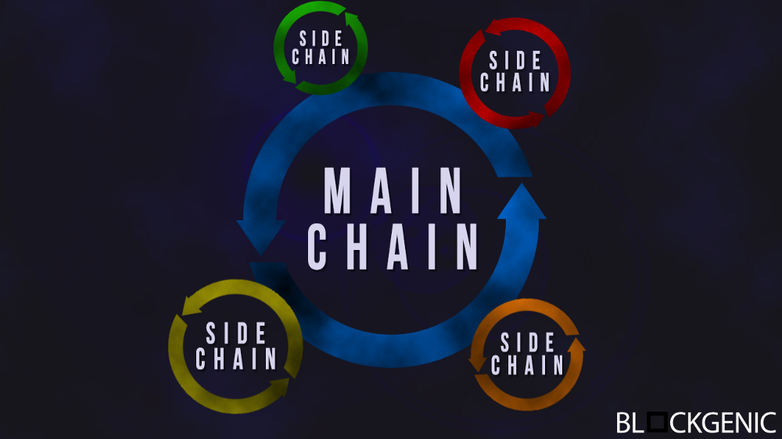
Layer 2 Solutions – Off-chain & Sidechains
Image Courtesy: https://cdn-images-1.medium.com/max/1000/1*WO8UqDyrAN8_BT8zbLSBFQ.png

Slide 14
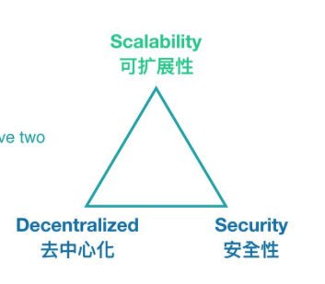
Scalability Trilemma
First coined by Vitalik Buterin
Concerns the issue of development of a scalable, decentralized and secure blockchain without compromising any of these properties
Scalability solutions compromise either decentralization or security aspect
Image Courtesy- https://cdn-images-1.medium.com/max/800/0*kAeB2L9FQhCCs8EE

Slide 15
Scalability Trilemma (contd…)
One of the “hot” research topic in blockchain technology
Example of scalability trilemma
Bitcoin is secure and decentralized, but not speedy.
Ripple XRP is speedy but less secure and has limited decentralization.
EOS is also not decentralized and is less secure, but it is speedy.
Ethereum is secure and decentralized but not speedy.

Slide 16
References Used
https://medium.com/@bitrewards/blockchain-scalability-the-issues-and-proposed-solutions-2ec2c7ac98f0
https://blockgeeks.com/guides/blockchain-scalability/
https://hackernoon.com/blockchain-scalability-layer2-bitcoin-ethereum-bb34afd1f9d2
https://en.wikipedia.org/wiki/SegWit
https://lucidity.tech/layer-2-blockchain-technology/
https://medium.com/coinmonks/sidechains-solving-the-blockchain-scaling-problem-b3847918b44
https://docs.zilliqa.com/whitepaper.pdf
https://medium.com/edchain/what-is-sharding-in-blockchain-8afd9ed4cff0
https://www.bitcoinlightning.com/wp-content/uploads/2018/03/lightning-network-paper.pdf
https://bitcoinmagazine.com/articles/op-ed-many-faces-sharding-blockchain-scalability/
https://en.wikipedia.org/wiki/Bitcoin_scalability_problem

Slide 17

Q & A?

